Slide 1

Theater Robotics for human technology education
Louis Li
Performing Robots Fall 2022

Slide 2
Catalog
Brief summary of the article (with case discussion)
Questions

Slide 3
Summary of the article
Background*
An international emphasis on computing skills and efforts to renew curricula based it (Educational Robotics is among them)
The demand of bringing real-life context into teaching
Emphasis of interdiscipinary pdagogical approaches and projects (ex. combine art and robotics together)

Slide 4
Summary of the article
Background
Robotics leanring environment emphasizes solely the development of technical skills, and pay little attention to the skills learned in humanity
The integration between these two aspects is very rare
The complicated part comes when the abovementioned skills are needed to combine with humanity subjects
Digital tools can be applied effectively in diverse contexts to cross inter-disciplinary borders

Slide 5
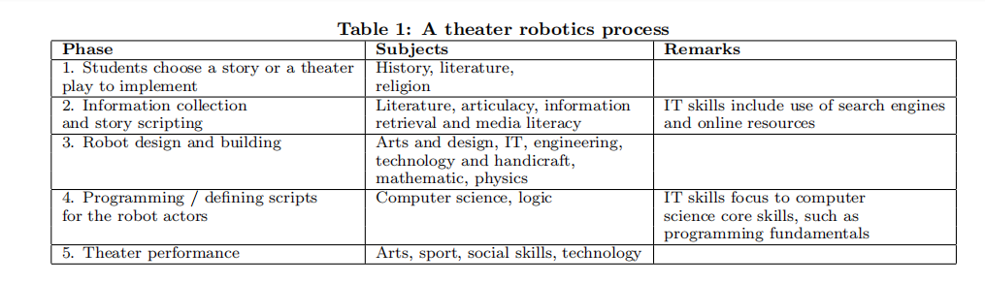
Summary of the article
Theater robotics framework
To complete a theater robotics project successfully, students are challenged to try and improve their skills in various school subjects within the same project (multidisciplinary nature)
Approach to culture*

Slide 6
Summary of the article
Theater robotics framework (Experiment)
Based on the theatre robotics concept in the SciKids' technology club of university of Eastern Finland. A group of 8-13 children present story of Red Riding Hood with Lego Mindstorms EV3 robotics sets
To analyze the feasibility of Lego Mindstorms robotics set for theater robotics
Flexibility, expandability, durability, and the total cost of the learning environment
The features of hardware and software that would be needed when implementing the theater robotics framework

Slide 7
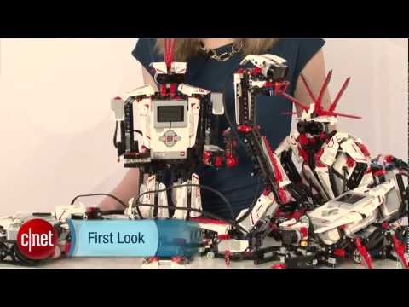
Summary of the article

Slide 8
Summary of the article
Theater robotics framework (Experiment)
RobotStory scripting
Robot actors
Stage
Central Director Unit

Slide 9
Summary of the article
RobotStory scripting
Users are adopting a role of a playwright or a scriptwriter when they are using the environment, rather than a traditional role of a programmer
The play is divided to a set of pages each presenting small sketches which visualize events on a stage
Pages are created by defining actions for the actor robots with a graphical user interface
"Learn coding through playing"

Slide 10
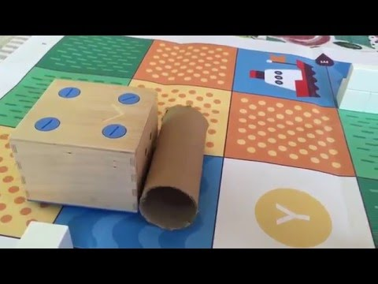
Summary of the article
Cubetto: Coding for kiddos

Slide 11
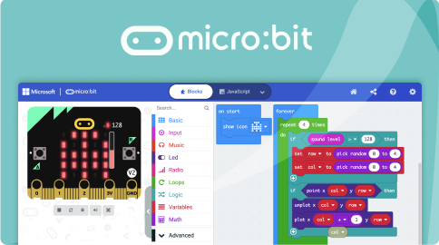
Summary of the article

Slide 12
Summary of the article
Robot actors (Arduino)
A Bluetooth module is needed for connecting the Central Director Unit with the robot
Special infrared LEDs are needed for positioning the robots with stage module’s machine vision system
Stage (Computer vision)
The stage is equipped with a robot positioning system implemented using a machine vision approach
To make the robot actors behave properly, there is an absolute need to detect their position on the stage
Central Director Unit (Raspberry PI 2)
Using Raspberry Pi 2, a credit-sized low-cost computer to maintain communication between different parts of the system

Slide 13
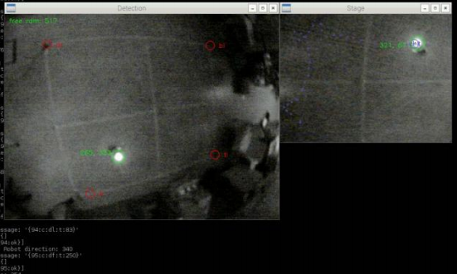
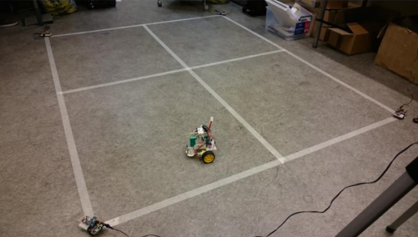
Summary of the article

Slide 14
Summary of the article
Conclusion: Still not inclusive enough
Many robotics used for educational purposes including the Lego one is too expensive for deployment
existing programming solutions for educational robotics are geared towards traditional procedural or objectoriented programming approach and they do not support the inter-disciplinary motivation behind theater robotics: to combine storytelling with the learning of technology
Complexity is underestimated

Slide 15
Discussion questions
How have your life and perception of things changed after learning computing?
Do you think this kind of interdisciplinary and project-based computing learning can replace the current learning system, or it can just be a supplement, why?
Putting yourself in the students' shoes, how do you view the effectiveness/shortcoming of this kind of interdisciplinary and project-based computing learning (consider IM as an example?)
Do you think this way of learning can really spread in the global education framework?

